Slide 1
Modeling Wine Quality: Investigating the Role of Alcohol Content
Authors:
Patrycja Szostak, Oliver Tischer,
Luis Dlugos

Slide 2
Research Question:
Does higher alcohol content lead to better wine quality?
Notes:
In this project we wanted to explore whether alcohol content could be used as a reliable predictor of wine quality – and whether red and white wines behave the same.

Slide 3
INTRODUCTION
01

Slide 4
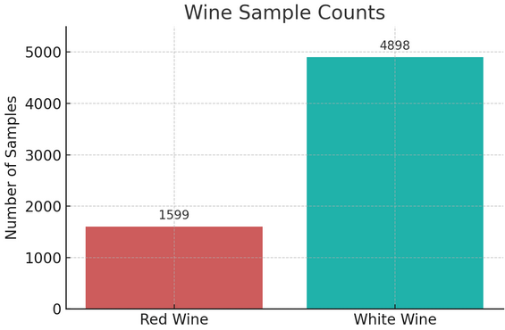
Introduction & Dataset Overview
Source: UCL Machine Learning Repository
2 Datasets: Red wine (winequality-red.csv) and White wine (winequality-white.csv)
Samples:
Red wine: 1599 entries
White wine: 4898 entries
Features: 11 physicochemical variables
Target variable: quality
No missing values
Notes:
In this project, we investigate whether alcohol content has a measurable impact on wine quality, using two real-world datasets of red and white wines.
Each wine sample is described by lab-measured features, making it ideal for applying machine learning and statistical analysis.
No missing values = no missing data. → that was checked

Slide 5
02
Chemistry behind wine features.

Slide 6
Acidity and Taste Balance
Features that shape the wine’s freshness, structure and drinkability.
Residual Sugar - unfermented sugar (glucose/fructose) left after fermentation.
In red wine: various values, gives different sweetness.
In white wine: Slightly higher than reds on average. Important for balance.
pH - Measures acidity strength. Lower pH = more acidic
In red wine: around 3.4–3.6. Affects stability, taste, and colour tone.
In white wine: Lower pH (3.0–3.3) more common. Helps preserve freshness.
Fixed Acidity - primary tartaric and malic acid.
In red wine: sharpness, freshness; balances fruitiness. Harsh taste if too much.
In white wine: crispness, as white more acid-driven.
Volatile Acidity - mostly acetic acid (vinegar component).
In red wine: High levels indicate spoilage. Low levels are normal.
In white wine: Even small increases are noticeable and undesirable.
Citric Acid - used to add acidity, can be an additive.
In red wine: less common.
In white wine: Sometimes added to enhance freshness in whites. Can slightly improve taste.
Notes:
In order to better understand our dataset, we learned meanings of each of the features and what values we can expect based on the chemical importance. I believe that we shouldn’t fully separate numbers from their meaning when analysed therefore in my eyes this was crucial for deeper understanding of the problem in our research.
Divide into groups for better clarity

Slide 7
Stability and Preservation
Impact shelf life and oxidation.
Chlorides - represent salt content, mainly sodium chloride.
In red wine: rare in red wines, if present salty and metallic notes.
In white wine: more sensitive to presence of chlorides (may come from storage or winemaking water).
Free Sulfur Dioxide - antioxidant and antimicrobial agent.
In red wine: preserves freshness and colour, used sparingly.
In white wine: critical, prevents oxidation and browning.
Total Sulfur Dioxide – all bound and free SO2 in the wine.
In red wine: lower, as tannins and anthocyanins give natural protection.
In white wine: significantly higher, essential. Keep freshness and stability.
Sulphates – potassium metabisulfite. Added but also occurs naturally.
In red wine: aid in microbial control and shelf control. Moderate use.
In white wine: provide stability and freshness. Higher use.
Notes:
In order to better understand our dataset, we learned meanings of each of the features and what values we can expect based on the chemical importance. I believe that we shouldn’t fully separate numbers from their meaning when analysed therefore in my eyes this was crucial for deeper understanding of the problem in our research.
Divide into groups for better clarity

Slide 8
Body, Strength & Overall Quality
Drive the wine’s mouthfeel and scoring.
Density - mass per volume (g/mL). Correlates with alcohol and sugar content.
In red wine: lower density usually means higher alcohol, higher density – may suggest sugar.
In white wine: same as in red.
Alcohol - ethanol, produced during fermentation from sugar.
In red wine: higher alcohol enhances mouthfeel and perceived sweetness.
In white wine: similar effects, might overpower lighter wines.
Quality (target feature) - human sensory rating based on taste, aroma and balance. Given by professionals.
In red wine: more body, tannin and complexity expected (structure).
In white wine: Balance of freshness, fruit and acidity. Preferable clean and aromatic profile.
Notes:
In order to better understand our dataset, we learned meanings of each of the features and what values we can expect based on the chemical importance. I believe that we shouldn’t fully separate numbers from their meaning when analysed therefore in my eyes this was crucial for deeper understanding of the problem in our research.
Divide into groups for better clarity

Slide 9
03
Exploratory Data Analysis (EDA): Getting to Know the Wines

Slide 10
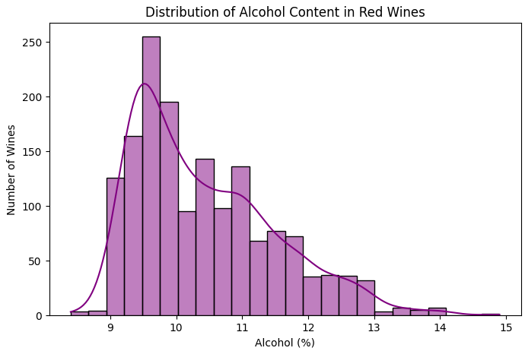
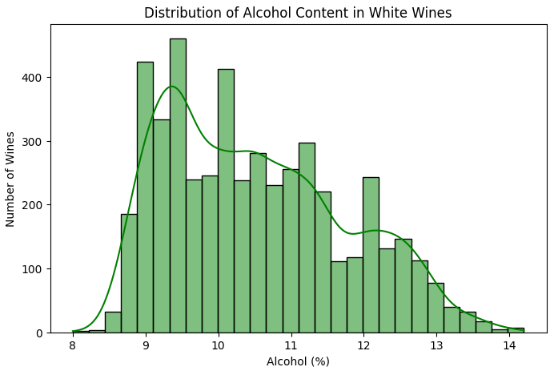
Alcohol Distribution
Average alcohol content: 10.42%
Alcohol range: 8.4% - 14.9%
Average alcohol content: 10.51%
Alcohol range: 8.0% - 14.02%
Notes:
As discussed, in response to feedback – we treated sets separately instead of merging them, so for Exploratory Data Analysis I generated graphs for each set to tackle different patterns. Here we take a closer look at the distribution of alcohol content in red and white wines — which is the core feature we’re investigating in our project.
Histograms…
We mainly focus on alcohol here due to our research question
Red wine:
Right-skewed distribution: Most wines cluster in the lower alcohol range with a long tail extending to higher values
Peak around 9.5%: This is the most common alcohol level for red wines
Normal range: The majority of red wines fall between 9.5-11% alcohol
White wine:
The alcohol distribution here is a bit more spread out
Right-skewed distribution: Most wines cluster in the lower alcohol range with a long tail extending to higher values
Peak around 9-9.5%: This is the most common alcohol level for white wines
Normal range: The majority of white wines fall between 9-12% alcohol
Visually, we can already notice that white wines tend to cluster more evenly across the spectrum, while red wines show a more defined peak. This is a first clue that alcohol might behave differently across wine types — and we’ll investigate that in more detail later in the analysis.

Slide 11
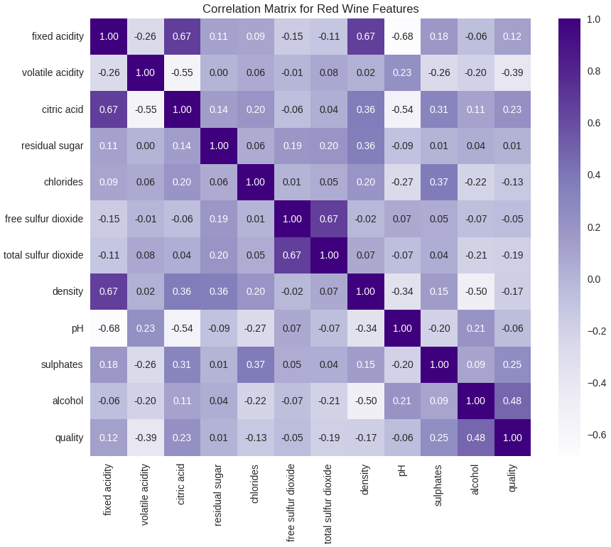
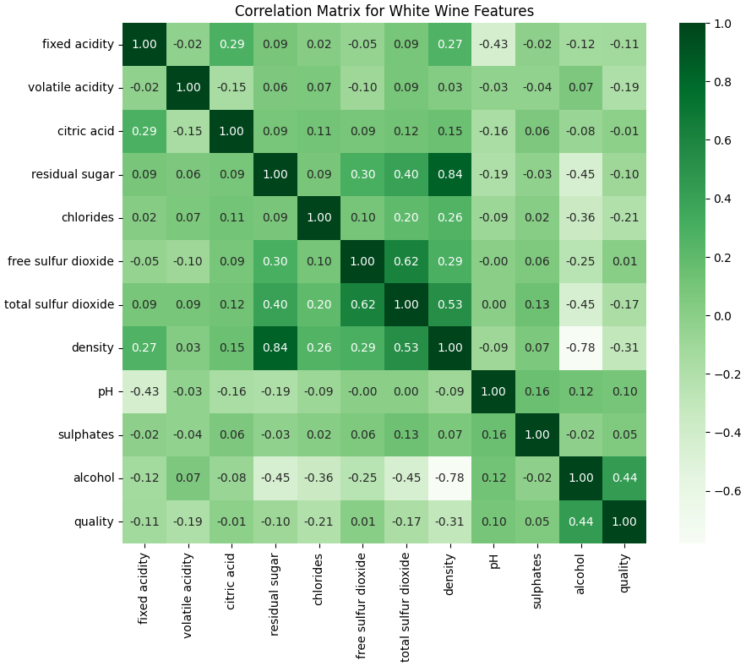
Feature Correlations
Which Features Drive Wine Quality?
Notes:
Heatmap (correlation matrices)

Slide 12
Feature Correlations
Which Features Drive Wine Quality?
Notes:
Heatmap (correlation matrices):
Starting with red wines on the left — you’ll notice alcohol stands out with the strongest positive correlation to quality, at 0.48. That means: as alcohol increases, so does the perceived quality — but we’ll come back to whether that always holds.
The second strongest positive correlation is with sulphates (0.25), which are important for stability and microbial control. Interestingly, volatile acidity and density show negative correlations with quality — indicating that too much acidity or too much sugar may lower a wine’s score.
For white wines, on the right — alcohol again correlates positively with quality, though slightly lower (0.44). But here we see other features playing stronger roles. Density has a stronger negative correlation (−0.31), and free sulfur dioxide also shows some impact.
What’s important is that the patterns differ by wine type — and this gives us an early hint that the alcohol-quality relationship might be more complex than it first appears.
Red:
Alcohol
Sulphates
Citric acid = body, structure, and preservation.
White:
Density
Free sulfur dioxide

Slide 13
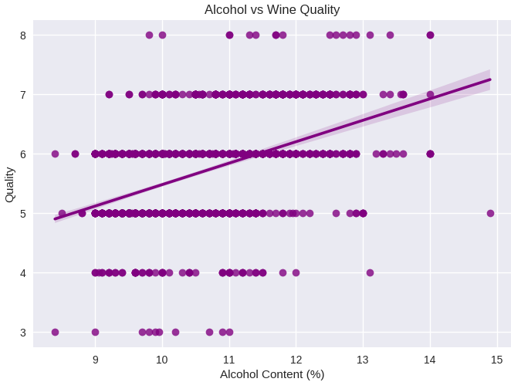
Pearson Correlation – red wine
Pearson Correlaton score: 0.4762
Notes:
“While alcohol content shows a generally positive linear relationship with wine quality, the plateau at higher quality scores suggests the presence of complex, non-linear interactions with other features.”
Pearson correlation confirms linearity on average, but…
Scatter plots show that the relationship isn't strictly linear throughout.
This scatter plot shows the relationship between alcohol content and wine quality — specifically for red wines, where each dot represents one wine sample.
clearly see a positive trend — wines with higher alcohol levels tend to score higher on quality.
That means alcohol is not just randomly related to quality — it’s one of the key drivers. But notice: it’s not perfectly linear — some high-alcohol wines still receive average ratings, which suggests that alcohol is important, but not the only factor.

Slide 14
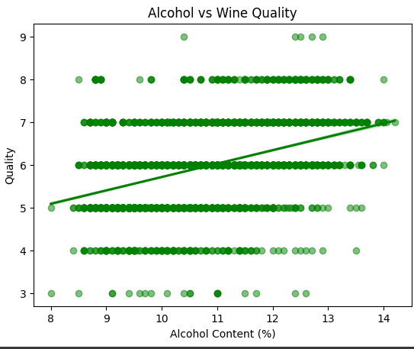
Pearson Correlation – white wine
Pearson Correlaton score: 0.4356
Notes:
“While alcohol content shows a generally positive linear relationship with wine quality, the plateau at higher quality scores suggests the presence of complex, non-linear interactions with other features.”
Pearson correlation confirms linearity on average, but…
Scatter plots show that the relationship isn't strictly linear throughout.
Now, let’s look at the same relationship — but for white wines.
Again, we see a positive correlation between alcohol content and wine quality, but it's slightly weaker — at 0.44 compared to 0.48 for red wine.
The upward trend is still there — higher alcohol generally means better scores — but the points are more spread out. That means there's more variation in how white wines are rated at similar alcohol levels.
So although alcohol is still important, this plot already hints that other factors — like acidity or sulfur dioxide — might play a stronger role in determining white wine quality. We’ll explore that further in the modeling phase.

Slide 15
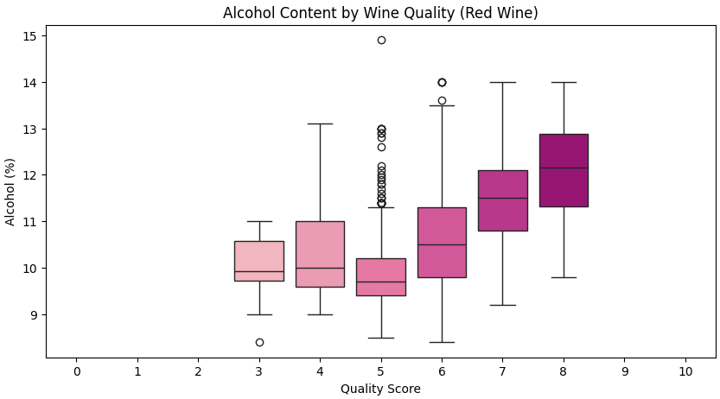
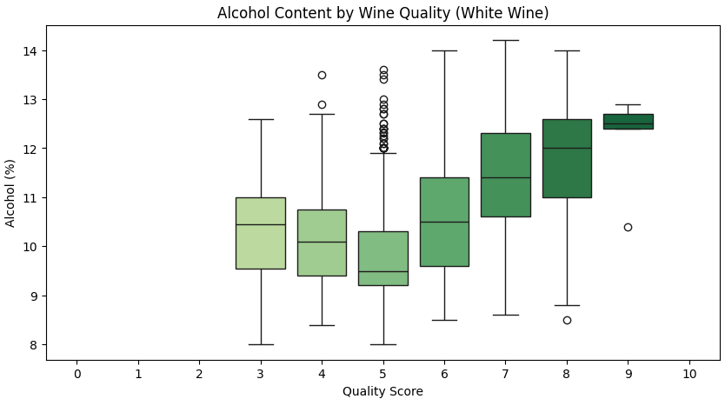
Alcohol vs. Quality
Strong positive correlation: Both red and white wines show clear upward trends where higher alcohol content correlates with better quality scores, with quality 3-5 wines averaging ~10% alcohol versus quality 7-8 wines reaching ~12-13% alcohol.
Not perfectly linear relationship: The alcohol-quality relationship levels off at the highest quality wines, meaning very high alcohol doesn't always guarantee better quality (however upward trend can be observed, especially in red wine).
Wine type differences: Red wines demonstrate more dramatic alcohol increases with quality improvement, while white wines show more gradual progression and higher variability within quality categories.
Notes:
Box plots:
This boxplot visualizes the distribution of alcohol content across wine quality scores for red and white wines.
We see a strong positive trend — higher quality wines generally have higher alcohol content. In red wines, the median shifts from around 10% at quality 3–5 to over 12% at quality 7–8.
While the trend is also present in white wines, it’s more gradual, and there’s greater variability within each quality level.
Outliers are visible across all categories, showing that alcohol alone doesn’t fully determine quality.
Initial finding: EDA suggests alcohol content is a promising predictor, but ML analysis needed to confirm causal relationships and relative importance and assess alcohol's importance relative to other chemical properties.
! Correlation ≠ Causation: Higher alcohol may be a byproduct of better grapes/processes, not the cause.
Overall, we observe a not perfectly linear relationship — the trend plateaus at higher quality levels. This insight was crucial in guiding our modeling approach, where we avoided purely linear methods and focused on models that capture non-linear interactions

Slide 16
Key Takeaways
EDA reveals that alcohol is likely the most influential predictor of quality.
Other features indicate influence on quality as well.
EDA helps build intuition before applying machine learning methods.
Wine type matters as red wines show slightly stronger alcohol-quality correlation (0.48) than white wines (0.44)
Not perfectly linear relationship observed - quality improvement plateau at higher alcohol levels suggests complex interactions. This insight warns us: 'more alcohol = better wine' is an oversimplification — especially at higher quality levels – crucial information in terms of ML modeling.
Notes:
Algorithm Selection:
Linear models (like simple regression) will perform poorly because they assume constant relationships
Tree-based models (Random Forest, XGBoost) or polynomial features will capture these curves better
Prediction accuracy: Non-linear models will likely outperform linear ones significantly.
Alcohol appears to be the strongest single predictor of wine quality across both datasets.
However, other features — such as sulphates, density, and sulfur dioxide — also show meaningful influence – this could be seen in our datasets but also we learnt from chemical properities that they play also important role
These patterns helped us build an intuitive understanding of the data before applying any machine learning models
We also saw that wine type matters — red wines show a slightly stronger correlation between alcohol and quality (0.48), compared to white wines (0.44).
Finally, the relationship between alcohol and quality is not perfectly linear. We observed a plateau effect at higher alcohol levels, especially in red wine — which means more alcohol doesn’t always equal better wine
This complexity made it clear that linear models would be too limited for this problem — so we turned to decision trees and ensemble methods that can handle these kinds of non-linear interactions.”

Slide 17
04
Predictive Modeling Using Machine Learning
With a focus on alcohol content

Slide 18
Initial Modeling Phase – Red Wine
Decision Tree (all features)
Decision Tree (Top Features)
Baseline Model
Confusion Matrix
Identify key predictive features
Reduce dimensionality for simpler modeling
Test model using top predictors only
Compare performance with full-feature model
Apply more advanced ML method
Check improvement over single decision tree
Feature Importance Analysis
Random Forest (Top Features)

Slide 19
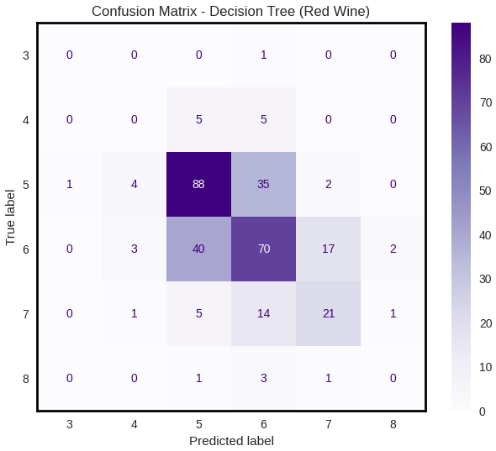
Decision Tree - All Features
Key insights:
Reasonable performance (56% accuracy)
Better than random guessing (16.7% for 6 classes: 3,4,5,6,7,8)
Best at middle range wines – performs best on quality 5 (most common type) and struggles with rare – very low or very high quality wines
Most mistakes happen between neighboring scores (5-6, 6-7)
Wine quality is difficult in predicting and this model shows the complexity of the problem
Room for improvement - this baseline shows our research question is worth pursuing
Accuracy: 0.56

Slide 20
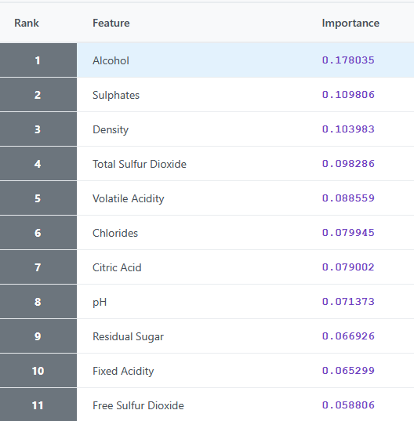
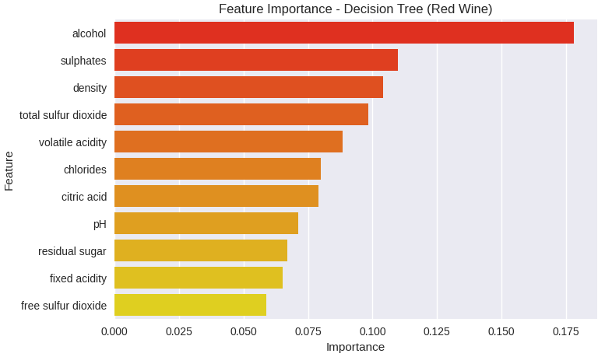
Feature Importance Analysis
Feature importance shows which attributes the model relies on most — but alone, it doesn't guarantee predictive accuracy or answer our research question.
Notes:
Alcohol content ranks highest supporting our research hypothesis.

Slide 21
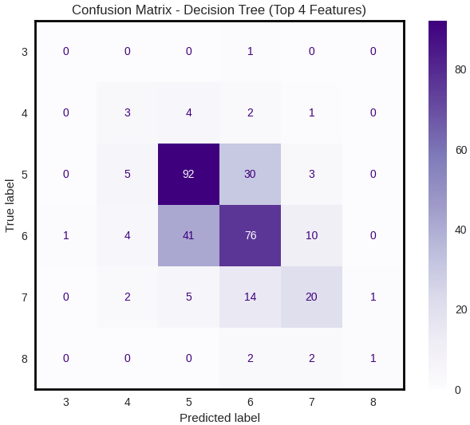
Decision Tree – Top Features
Key Insights:
Best results with 4 top features (alcohol, sulphates, density, total sulfur dioxide)
Improved performance (60% accuracy vs. 56% with all features) - top features outperform full model
Most mistakes still between neighbouring scores (5-6, 6-7) - pattern remains consistent
Efficiency gains - better accuracy with fewer features (noise reduction)
Feature selection improves both simplicity and performance
Accuracy: 0.60
Notes:
Why? Smaller models are faster, simpler, and sometimes surprisingly more accurate when noise is reduced.
Reasons for performing this: Feature reduction experiment - testing if fewer, more important features can maintain performance
Simplification benefit - easier model interpretation and faster training
Overfitting prevention - reducing features can improve generalization

Slide 22
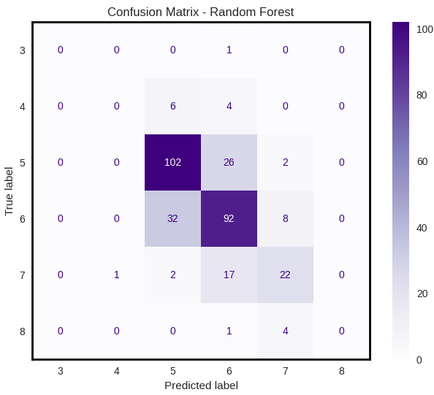
Random Forest – Top Features
Key Insights:
Good performance (68% accuracy)
Significant improvement over Decision Tree (68% vs. 60%)
Strong performance on common wines - quality 5 and quality
Most mistakes still between neighbouring scores (5-6, 6-7) - pattern remains consistent across all models
Ensemble advantage confirmed - multiple trees capture wine quality patterns better than single tree
Feature selection success validated - top 4 features with Random Forest achieve optimal balance of simplicity and accuracy
Accuracy: 0.68

Slide 23
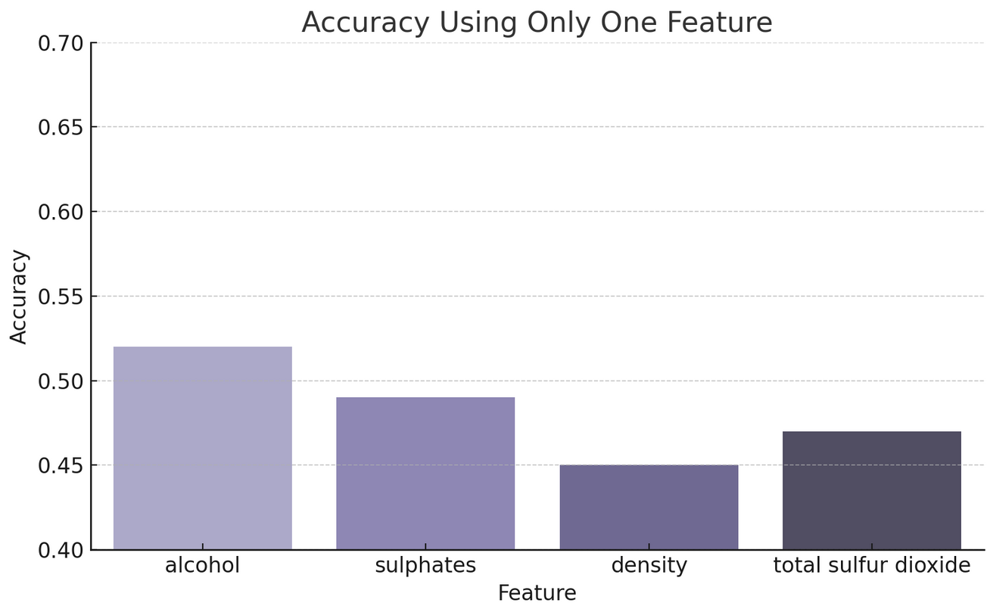
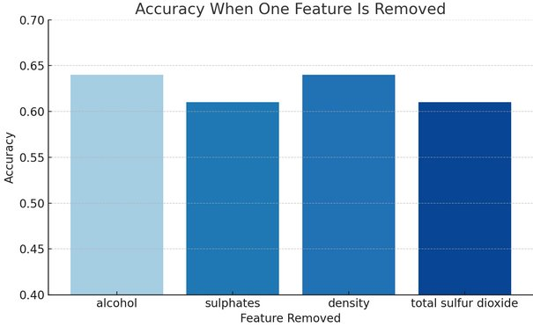
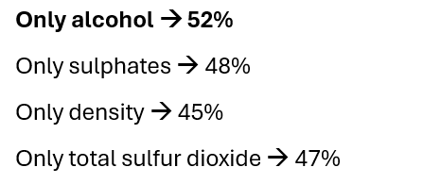
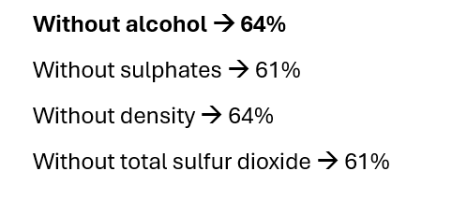
Additional Ablation Tests – Red Wine

Slide 24
Initial Modeling Phase – White Wine
Decision Tree (all features)
Random Forest (All Features)
Baseline Model
Confusion Matrix
Assess feature importance
Keeping all features
Apply ensemble method
Check improvement over single decision tree
Feature Importance Analysis
Notes:
Why ? I found that multiple features contribute meaningful information, and no small subset dominated strongly enough to justify feature reduction.
predictive power was spread across more features — so reduction didn’t help.

Slide 25
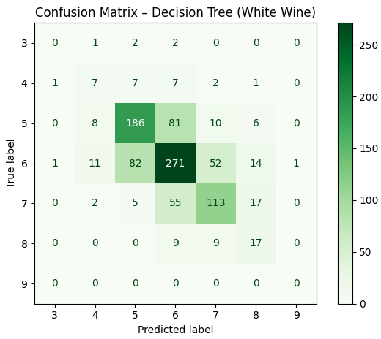
Decision Tree – All Features
Key Insights:
Good performance (61% accuracy)
Better than random guessing (14.3% for 7 classes: 3,4,5,6,7,8,9)
Best at middle range wines - performs best on quality 5-6 (most common types) and struggles with rare quality wines
Most mistakes happen between neighboring scores (5-6, 6-7)
Severe class imbalance - extreme quality wines (3,4,8,9) rarely represented in predictions
Wine quality is difficult in predicting and this model shows the complexity of the problem.
Room for improvement - this baseline shows our research question is worth pursuing
Accuracy: 0.61
Notes:
- 56% accuracy

Slide 26
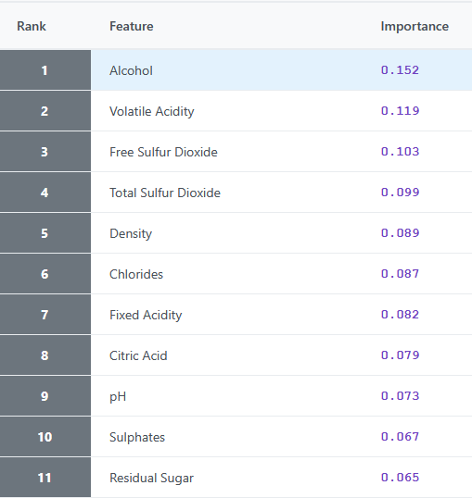
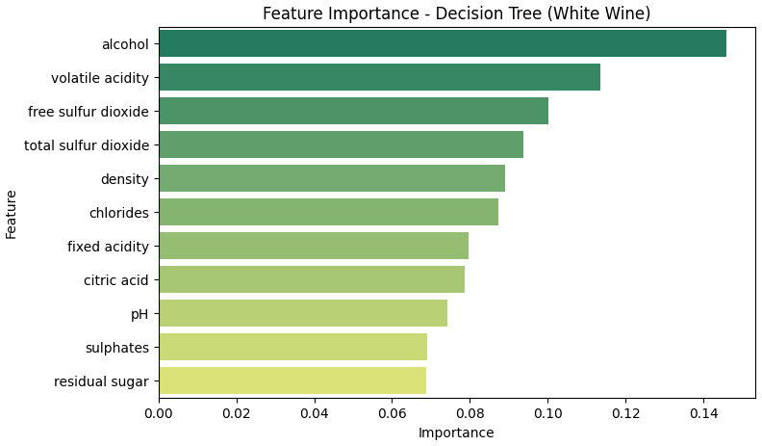
Feature Importance Analysis
Feature importance shows which attributes the model relies on most — but alone, it doesn't guarantee predictive accuracy or answer our research question.
Notes:
Alcohol content ranks highest supporting our research hypothesis.
We didn’t use top features in this case as using all of them was giving the same results, we used GridSearchCV but didn’t improve accuracy massively (only by 1%) – don’t know if I used it right …. -> hyperparameter tuning
predictive power was spread across more features — so reduction didn’t help.

Slide 27
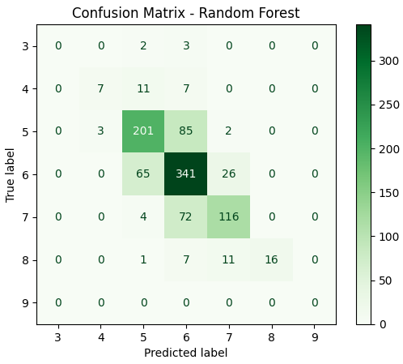
Random Forest – All Features
Key Insights:
Strong performance (69% accuracy)
Better than baseline
Excellent at middle range wines - quality 5 and quality 6
Most mistakes happen between neighbouring scores (5-6, 6-7)
Ensemble method advantage - Random Forest captures complex wine quality patterns effectively
Severe class imbalance - quality 3,4,8,9 poorly predicted
Next step: class balancing techniques to boost minority class performance
Accuracy: 0.69

Slide 28
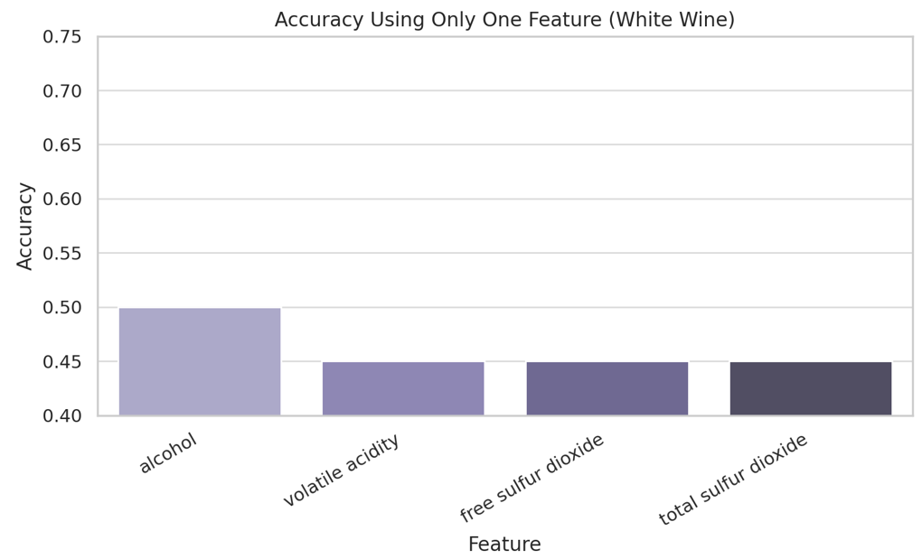
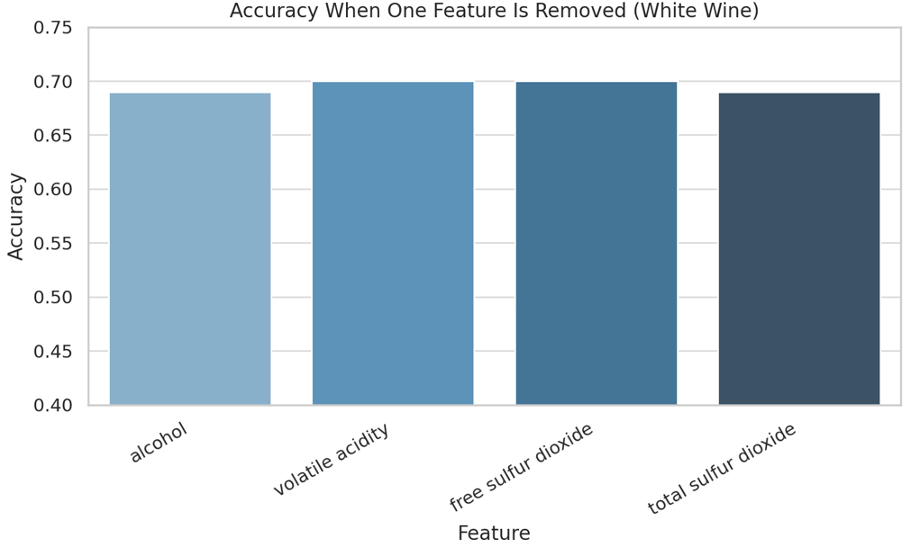
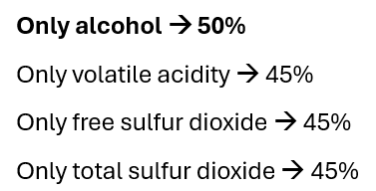
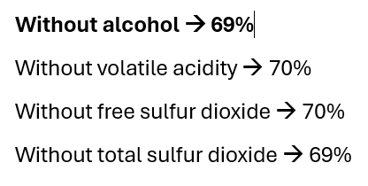
Additional Ablation Tests
Notes:
We can see a contradiction. This suggests that the model is not overly dependent on any single feature, and that there are strong interactions or redundancies between variables.
It also confirms that Random Forest is robust — it can compensate for missing information by relying on patterns captured by other trees or features.
In short: no single feature is irreplaceable. Even the top ones can be dropped with minimal performance loss — which shows that quality is influenced by complex combinations, not isolated attributes.

Slide 29
Key Conclusions – Ablation Tests & Feature Imbalance in Red & White Wine
Alcohol is strongest single predictor - validates our research hypothesis across both wine types
Feature interactions matter more than individual features - alcohol's impact depends on context with other chemical properties
Optimal feature selection varies by wine type - red wines benefit from top 4 features, white wines improve by removing volatile acidity or free sulfur dioxide
While alcohol leads to better quality, it's not the whole picture. Presence of other important features is crucial for performance
Models is robust - no single feature is irreplaceable due to feature interdependencies
Severe dataset imbalance affects both types - models heavily bias toward common quality scores (5-6). White wines showing more extreme imbalance
Performance concern - decent accuracy may result from "smart guessing" dominant classes rather than true learning
Rare quality prediction fails - extreme scores (3,4,8) consistently misclassified due to insufficient samples
Next step - dataset balancing is needed for more reliable evaluation

Slide 30
05
Addressing Class Imbalance in Wine Quality Data

Slide 31
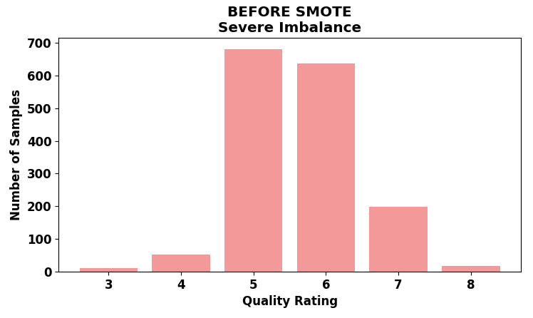
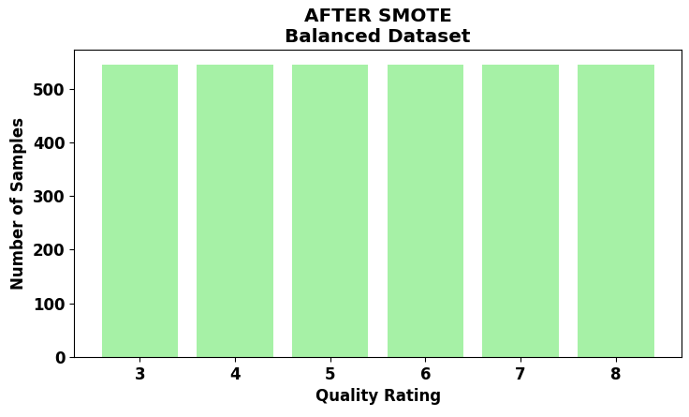
The Class Imbalance Problem in Red Wine
SEVERE CLASS IMBALANCE DETECTED:
- Quality 5: 681 samples (42.6%)
- Quality 6: 638 samples (39.9%)
- Quality 3: 10 samples (0.6%) ← CRITICAL PROBLEM
- Quality 8: 18 samples (1.1%)
IMPACT ON RESEARCH:
- Models biased toward common wines (5-6)
- Cannot reliably evaluate rare excellent/poor wines
- Research question compromised - alcohol's role unclear for ALL quality levels

Slide 32
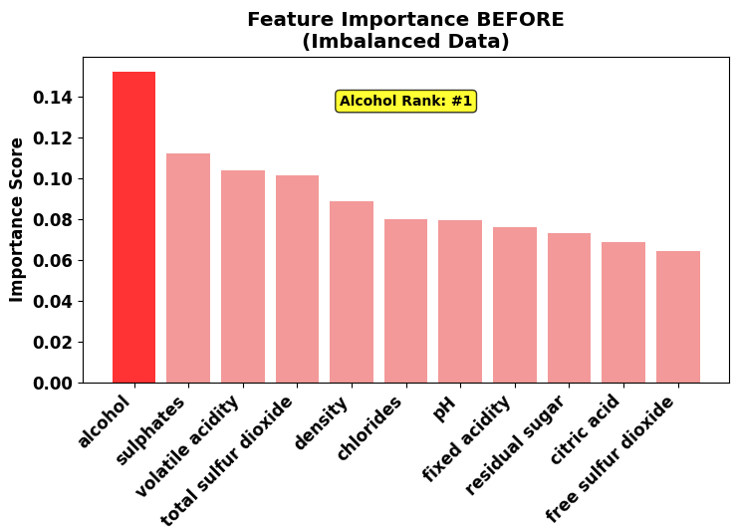
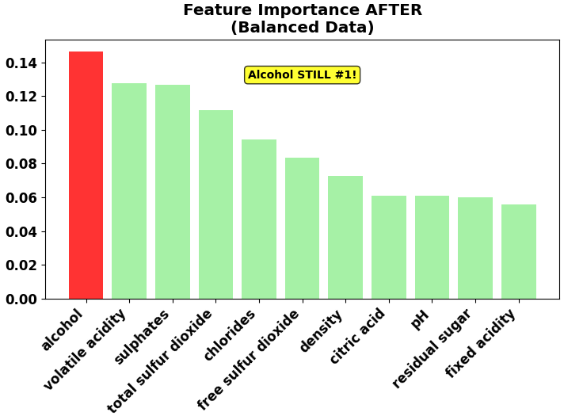
SMOTE Solution & Validated Results for Red Wine
SMOTE RESULTS - RED WINE:
RESEARCH QUESTION CONFIRMED: Higher alcohol → better quality
KEY EVIDENCE:
- Alcohol remains #1 predictor (14.6% importance)
- Correlation unchanged: 0.476 (strongest)
- Quality 8 wines: 12.4% alcohol
- Quality 3 wines: 9.9% alcohol
- Difference: +2.5% alcohol for best wines
MODEL PERFORMANCE:
- Accuracy: 68% → 63% (expected trade-off)
- Better minority class detection
- More reliable across ALL quality levels

Slide 33
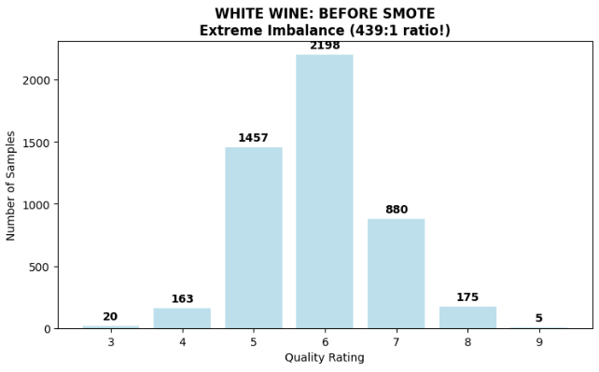
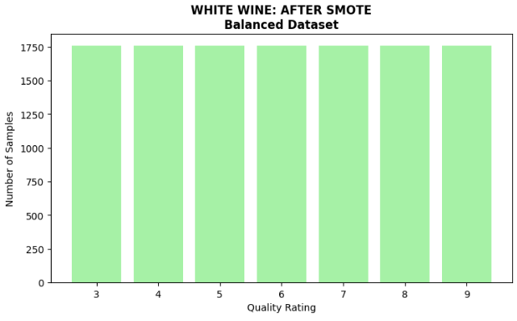
The Class Imbalance Problem in White Wine
EXTREME CLASS IMBALANCE DETECTED:
- Quality 6: 2,198 samples (44.9%)
- Quality 5: 1,457 samples (29.7%)
- Quality 9: 5 samples (0.1%) ← CRITICAL PROBLEM
- Quality 3: 20 samples (0.4%)
IMPACT ON RESEARCH:
- Even worse than red wine (439:1 vs 68:1 ratio)
- 7 quality classes vs 6 in red wine
- Models extremely biased toward common wines (5-6)
- Cannot evaluate rare premium/poor wines
- Research question validity uncertain across ALL quality levels

Slide 34
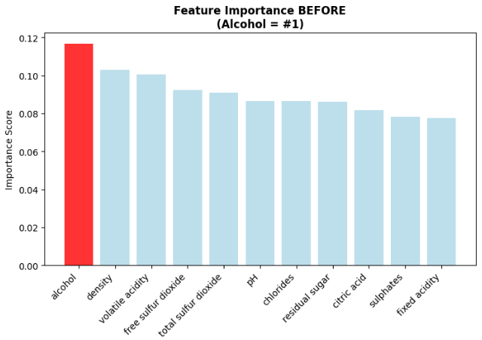
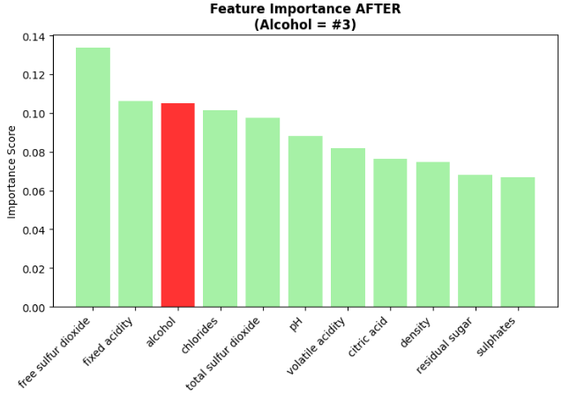
SMOTE Solution & Validated Results for White Wine
SMOTE RESULTS - WHITE WINE:
RESEARCH QUESTION CONFIRMED: Higher alcohol → better quality BUT different pattern than red wine!
KEY EVIDENCE:
- Alcohol correlation: 0.436 (strong, but lower than red wine's 0.476)
- Alcohol ranking: #1 → #3 after SMOTE (reveals true importance)
WHITE WINE DIFFERS FROM RED WINE:
- Alcohol important but NOT dominant factor
- Free sulfur dioxide & fixed acidity more critical
- Preservation factors matter more in white wine
MODEL PERFORMANCE:
- Accuracy: 68% → 64% (expected trade-off)
- Better minority class detection
- More reliable across ALL 7 quality levels

Slide 35
Conclusions & Research Question
Does higher alcohol content lead to better wine quality?
Higher alcohol content is significantly associated with higher wine quality scores, especially in red wines. However! This is not always the case, and alcohol alone does not fully explain how wine quality is perceived.
Key Findings:
Alcohol showed the strongest correlation with quality among all features.
In red wine, the relationship was clearer and more consistent.
In white wine, other features such as free sulfur dioxide and acidity had stronger influence after balancing.
The relationship between alcohol and quality is not perfectly linear – beyond a certain point, higher alcohol doesn't always mean better quality.
Machine learning models (Random Forest) confirmed that alcohol is a key predictor in red wine and very important in white, but performance improves when it's combined with other features.
Limitations:
Size of datasets
Models are based only on physicochemical data – they do not include sensory features (e.g. colour)
The quality label is subjective and based on human scoring.
Notes:
+ Size of dataset – red less entries than white …
As expected, sulphates play a supporting role in both preservation and modeling performance.
Chemistry …
Features like alcohol, density, and sulfur dioxide, which affect taste and preservation, were also the most influential predictors in our models.
There were some surprises — for example, volatile acidity and free sulfur dioxide had high importance scores but turned out to be non-essential in ablation tests, suggesting redundancy.
And residual sugar, while chemically significant, showed little predictive power — likely because sweetness alone doesn’t drive expert wine ratings.

Slide 36
Tools & Methods Used
Exploratory Data Analysis (EDA):
Python, Pandas, Seaborn, Matplotlib
Distribution plots
Correlation matrices
Scatter plots and boxplots
Evaluation Metrics:
Accuracy score
Confusion matrix
Feature importance scores
Machine Learning Algorithms:
Decision Tree Classifier
Random Forest Classifier
Train-test split (scikit-learn)
Preprocessing and balancing:
Feature selection (top 4 features)
Ablation testing (removing/adding features)
SMOTE (Synthetic Minority Oversampling Technique) for class imbalance

Slide 37
Questions
Notes:
For a Decision Tree:
max_depth – how deep the tree can go
min_samples_split – minimum number of samples to split a node
criterion – how the tree decides where to split (e.g. gini vs entropy)
For a Random Forest:
n_estimators – number of trees in the forest
max_features – number of features to consider at each split

